Slide 1
Jermyn Borough Council Meeting
4/15/21

Slide 2
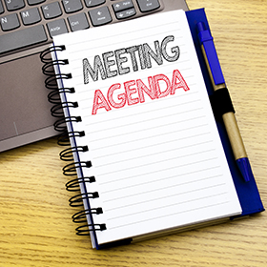
Meeting Agenda
Call to Order
Pledge of Allegiance
Roll Call
Previous Meeting Minutes
Ratify Paid Bills
Treasurer’s Report/Bills Payable
Correspondence
Public Comment
Professional Reports
Committee Reports
Borough Manager Report
American Recovery Plan
Bacon Street Sewer Project
Dwight Ave Paving Quotes
DCED Audit
Tax Collector Position
New Business
Adjournment

Slide 3
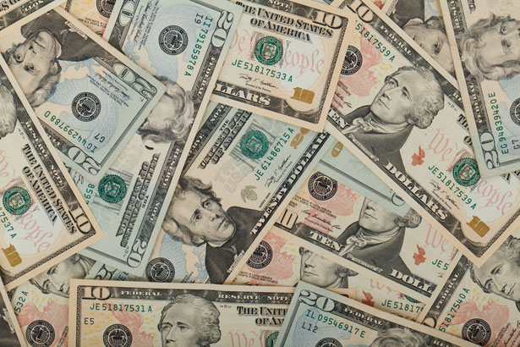
Treasurer’s report
4/15/21
ASSETS
    Capital Reserve - DPW 10,398.35
    Capital Reserve - Police 3,660.18
    Crime Watch Fund 755.44
    General Fund - Community 242,924.23
    General Fund - FNB 2957.40
    Holiday Lights Fund 516.14

Slide 4
Treasurer’s report
4/15/21
ASSETS
      Investment - General Fund 1,001.50
      Investment - Liquid Fuels 33,813.35
      Investment - Paving Fund 1,011.87
      Investment - Recycling 5,003.33
      Investment - Refuse 2,600.17
      Liquid Fuels - FNB 69,549.97
      Petty Cash 151.42
      Recreations Fund 13,249.54
      Recycling - Community 7,773.52
      Refuse Checking - FNB 27,410.42
Total Checking/Savings 425,383.51

Slide 5
Treasurer’s report
Accounts Payable 41,063.19

Slide 6
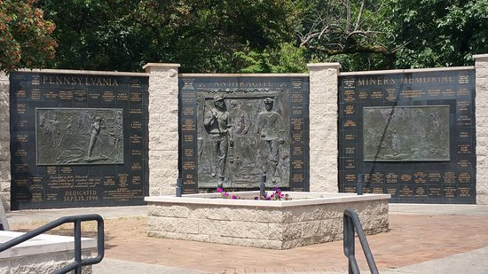

Slide 7
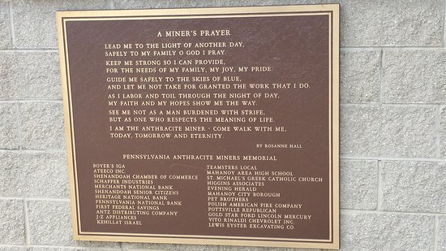

Slide 8
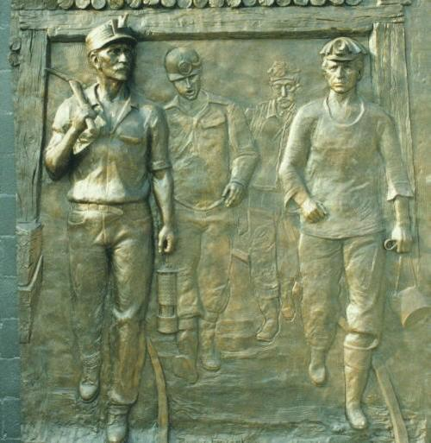

Slide 9
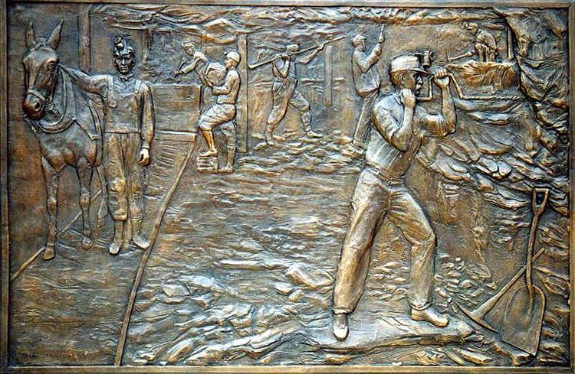

Slide 10
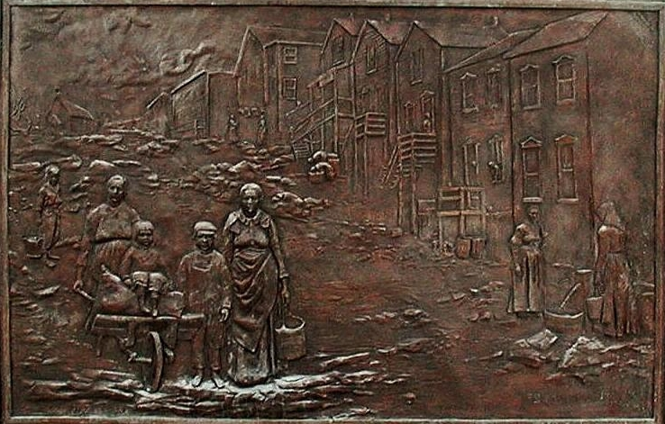

Slide 12


